Slide 1

System of Care Overview
___________________________________________________________
Adverse Childhood Experiences and Mental Illness
Notes:
The New Hampshire Children’s Behavioral Health Collaborative (CBHC) is a diverse network of individuals and organizations who work in partnership to transform the way we support children with behavioral health needs. The Collaborative supports state-level policy changes to transform New Hampshire’s children's mental health and substance use disorder system into an integrated, comprehensive System of Care that is youth and family driven, community-based, and culturally and linguistically competent

Slide 2
History of Children’s Behavioral Health Work in NH
No mention of children in the 2008 10-year Mental Health Plan
The Children’s Behavioral Health Collaborative (CBHC) was first convened in 2010 through a joint initiative of the NH Endowment for Health and the NH Charitable Foundation
Embraced a framework for system transformation
Issued a Strategic Statewide Plan in 2013
New Futures was selected to serve as the backbone organization in 2014
Notes:
The funders and founding members recognized that
Social-emotional well-being is fundamental to overall health and an important contributor to a child's success in school and in adulthood.
Many children, youth, and their families did not receive the supports and services they needed, when and where they needed them.
That it was our obligation as a State to address this problem head on
That something needed to be done to ensure we were supporting the healthy social and emotional development of NH’s future citizens and leaders – as a fundamental investment not only in our children’s future, but in our state’s future.
In 2013, the Collaborative produced the state’s first strategic plan to build an integrated and comprehensive service delivery structure.
The creation of the Collaborative’s State Plan in 2013, shared vision among governmental agencies, and grant writing resources helped to create an environment where NH could competitively apply for federal grants to advance the 2013 strategic plan and start building a System of Care for children with behavioral health needs
Behavioral health issues include the prevention and treatment of mental and substance use disorders

Slide 3

Public Private Partnership
Involved 50+ Organizational Partners
Articulated Shared Values & Guiding Principles
SCOPE WAS BROAD AND RECOMMENDATIONS TRANSFORMATIONAL!

Slide 4
Current Structure
The Collaborative has now become a project of
New Futures and is staffed by a
Policy Coordinator and a Community Engagement Coordinator
The Children’s Behavioral Health Program now works to implement the Plan through policy & advocacy, communications, community engagement, and partner-driven action within the workgroups to transform, cultivate, and strengthen
NH’s System of Care
Notes:
So how is this work getting done?
CBHC Work Groups
Behavioral Health Equity - NH Office of Health Equity (DHHS)
Policy - New Futures
Workforce Network - UNH Institute on Disability
Communications & Social Marketing - New Futures
Evaluation (inactive) - Antioch New England
System of Care Law (RSA 135-F) Committee - Bureau of Children’s Behavioral Health (DHHS) & Bureau of Student Wellness (DOE)

Slide 5
Workgroups
Policy Advisory Workgroup
Communications Workgroup
Behavioral Health Equity Workgroup
Workforce Development Workgroup
Notes:
In a collective impact initiative, organizations and community members work together at a systemic level to achieve a complex community-wide goal. They work to connect each intervention to other programs, organizations, and systems (including family and neighborhood systems) that influence the lives of beneficiaries.
Education, Outreach, Policy, Advocacy and Communications are all tied together!

Slide 6

What are the challenges we’re trying to address?
1 in 5 New Hampshire children and youth have diagnosable mental health disorders; genetic, or acquired due to adverse childhood experiences (ACEs).
Many children, youth, and their families do not receive the supports and services they need, when and where they need them
Children and youth with complex behavioral health challenges continue to encounter multiple systems that are uncoordinated
Notes:
For many youth, the disorder is so severe it impedes their ability to do well in school, at home, or in their communities
Every year the state of New Hampshire spends over $100,000,000 on children’s behavioral health services, and nearly 400 of the state’s children and youth are hospitalized due to a psychiatric emergency. Children and youth also end up committed to the state juvenile justice facility, or waiting in emergency rooms.
Many of these children and youth and their families find themselves in a complex web of programs and services, including school, mental health, child protection, substance abuse treatment, and justice systems. These families face complex, stress-filled, and difficult circumstances, and the complexities and demands of the service system can further overwhelm them.

Slide 7
Adverse Childhood Experiences (ACEs) and Toxic Stress
The CDC-Kaiser Permanente Adverse Childhood Experiences (ACEs) Study is one of the largest investigations of childhood abuse and neglect and household challenges and later-life health and well-being.
The original ACEs Study was conducted at Kaiser Permanente from 1995 to 1997 with two waves of data collection. Over 17,000 Health Maintenance Organization members from Southern California receiving physical exams completed confidential surveys regarding their childhood experiences and current health status and behaviors.
The ACEs Study – probably the most important public health study you never heard of – had its origins in an obesity clinic on a quiet street in San Diego.
Dr. Vincent Felitti, MD and Dr. Robert Anda, MD were the chief researchers of the study.

Slide 8
ACEs Questionnaire
While you were growing up, during your first 18 years of life:
1. Emotional Abuse
2. Physical Abuse
3. Inappropriate Sexual Activity
4. Loveless Family
5. Basic Needs Unmet
6. Divorced Parents
7. Domestic Violence
8. Substance Use Disorder in the Household
9.Mental Illness in the Household
10. Incarceration in the Household
Notes:
Give ACEs handout.

Slide 9
RSA 169 C (1979)
YOU are a mandatory reporter – even if you only suspect. And please don’t think others made the call.
https://www.gencourt.state.nh.us/rsa/html/NHTOC/NHTOC-XII-169-C.htm
Please call:
New Hampshire
Toll-Free: (800) 894-5533
Local (toll): (603) 271-6556
https://www.dhhs.nh.gov/dcyf/cps/stop.htm

Slide 10
Signs of Physical Abuse
SIGNS OF PHYSICAL ABUSE
• Bruises, welts, burns that cannot be sufficiently explained
• Injuries on places where children don't usually get hurt (the back, neck, back of legs, face)
• Repeated injuries
• Withdrawn, fearful or extreme behavior

Slide 11
Signs of Emotional Injury
SIGNS OF EMOTIONAL INJURY
• Inability to play as most children do
• Sleep problems
• Antisocial behavior
• Behavioral extremes
• Lags in emotional and intellectual growth
• Self destructive feelings or behavior

Slide 12
Signs of Sexual Abuse
SIGNS OF SEXUAL ABUSE
• Difficulty walking or sitting
• Pain or itching in the genital area
• Torn, stained or bloody underclothing
• Frequent complaints of stomachaches or headaches
• Chronic depression
• Withdrawal
• Feeling threatened by physical contact
• Inappropriate sex play or premature understanding of sex
• Running away from home

Slide 13
Signs of Neglect
SIGNS OF NEGLECT
• Chronically dirty
• Chronic school absences
• Dress inadequate for weather
• Left alone at home or without supervision
• Left in the care of siblings too young or unable to baby-sit
• Often fatigued or falling asleep in school
• Hunger
• Self destructive feelings or behavior

Slide 14
RSA 169 C (cont’d)
FREQUENTLY ASKED QUESTIONS
When Should I Report My Concern? If you know or suspect someone is being abused or neglected, state law requires that you immediately report your concerns to DCYF (children under 18 years old) or BEAS (adults 18 years old and older). Proof of abuse or neglect is not required before reporting. Reports can also be made directly to the police or 911.
What If I Am Mistaken? New Hampshire law states that any person who makes a report in good faith is immune from any civil or criminal liability (RSA 169-C and RSA 161-F).
Can I Remain Anonymous? Yes. We understand that reporting your suspicions is a big step to take. We also understand that you may be concerned about possible retaliation if they discover you reported your concerns.

Slide 15
Granite State
Children’s Alliance (GSCA)
The Granite State Children’s Alliance (GSCA) is a statewide chapter organization dedicated to putting the needs of New Hampshire’s child abuse victims first. Accredited by the National Children’s Alliance, the GSCA operates four Child Advocacy Centers (CACs), directly serving the children of Belknap, Cheshire and Hillsborough Counties. Please visit:
Knowandtell.org

Slide 16
Office of the Child Advocate
The Office of the Child Advocate was established in 2018 as part of an aggressive commitment to reform New Hampshire’s child welfare system. It is an independent and impartial state office established to oversee the Division for Children, Youth and Families (DCYF).
Dr. Moira O’Neill
https://childadvocate.nh.gov/

Slide 17
ACEs Story
Jenn Alford-Teaster

Slide 18

How do we help these children when we have a fragmented system of providers oftentimes working in silos?
Children & Families
Mental Health (CMHCs & CME)
Primary Care
Juvenile Justice
Child Protection
Medicaid & MCOs
Schools
SUD
Notes:
The Collaborative is working with partners to transform a fragmented system of providers, oftentimes working in silos.
Children and youth with behavioral health challenges continue to encounter multiple system that seldom work together and often have competing philosophies, different approaches and service gaps.
We still do not have a single point of entry for families to enter the system.
These system barriers conspire to leave children and families without access to the integrated supports needed to foster long-term health and well-being. They’re also expensive, ineffective, and harmful.

Slide 19
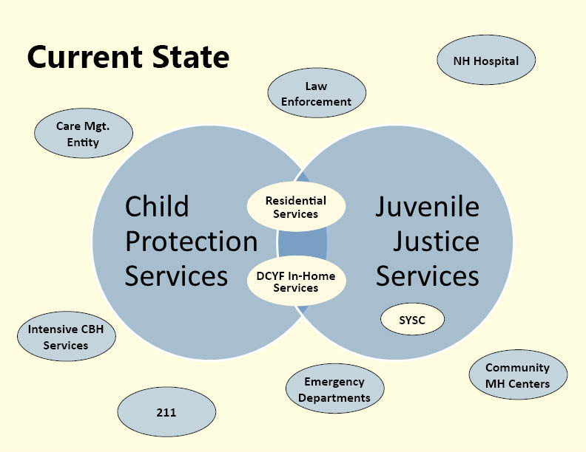
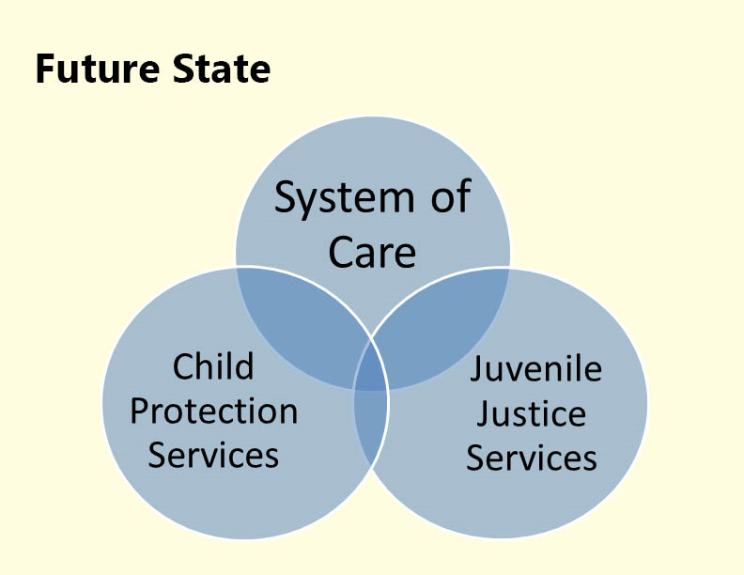
Child Welfare in New Hampshire
Presented to House Finance Division III
March 15, 2019
Joseph E. Ribsam Jr.

Slide 20

The Solution: A System of Care
A system of care is:
A spectrum of effective, community-based services and supports for children and youth with or at risk for mental health or other challenges and their families, that is organized into a coordinated network, builds meaningful partnerships with families and youth, and addresses their cultural and linguistic needs, in order to help them to function better at home, in school, in the community, and throughout life.
Stroul, B., Blau, G., & Friedman, R. (2010). Updating the system of care concept and philosophy. Washington, DC: Georgetown University Center for Child and Human Development, National Technical Assistance Center for Children’s Mental Health.
Notes:
The Collaborative embraced the System of Care framework when issuing the Strategic Statewide Plan in 2013
A System of Care is an organizational framework for system reform based on what families want and need.
It’s a value-based and evidence-based behavioral health approach which is designed to pull together the disparate service entities into one organized, coherent response.
Research shows that the system of care approach is a smarter investment that brings better outcomes for youth, as well as their families and communities.

Slide 21
System of Care Components/Values
Became a law in NH in 2016
  Youth & Family Driven
  Community-Based
  Culturally and Linguistically Competent
  Trauma Informed (Added in 2019 with SB 14)
Notes:
Family driven and youth guided, with the strengths and needs of the child and family determining the types and mix of services and supports provided.
Community based, with the locus of services as well as system management resting within a supportive, adaptive infrastructure of structures, processes, and relationships at the community level.
Culturally and linguistically competent, with agencies, programs, and services that reflect the cultural, racial, ethnic, and linguistic differences of the populations they serve to facilitate access to and utilization of appropriate services and supports and to eliminate disparities in care.
The System of Care Philosophy and Approach grounds everything we do and all the decisions we make! It helps us get everyone rowing in the same direction and singing from the same sheet of music. Whatever metaphor speaks to you!

Slide 22
RSA 135-F: NH’s System of Care Law
Outlines steps towards building a comprehensive and integrated System of Care for children’s behavioral health
Incorporates the System of Care values
Requires Interagency Coordination at the State level
Cornerstone to advancing the work of the CBH program and our State partners
Notes:
In 2016, NH passed Senate Bill 534, a major policy initiative of the Collaborative, which imbedded the system of care approach and accompanying values in RSA 135-F. The law requires the State to develop and maintain an integrated and comprehensive service delivery system for children with behavioral health needs.
Written by the CBHC policy committee.
Implementation remains a major policy priority of the CBHC
An advisory committee has been established to provide input into the creation of a system of care for children’s mental health of which CBHC is a part of
Commits state to system of care for children’s behavioral health
Requires an interagency agreement between DOE and DHHS
We are currently in Year 3 of implementation of the law
You can find the reports and other updates about the law on our website

Slide 23
RSA 135-F: NH’s System of Care Law (cont’d)
The law is very prescriptive
Requires planning process
Spells out plan components and key deliverables
Requires yearly progress reports
Each year the reporting requirements are increased
Notes:
The statute provides that the System of Care should provide services to ALL children receiving publicly funded behavioral health services and identifies SPECIFIC groups of children and youth that the System of Care work should impact.
Children in need of Services – RSA 169-D (DCYF/CHINS)
Juvenile Delinquency- RSA 169-B (DCYF/Delinquent)
Child Protection- RSA 169-C (DCYF/CPS)
Children with Disabilities- RSA-186-C (DOE/ Special Education)
Children and youth eligible for services under RSA 135-C (NH Hospital & CMHCs)
Children eligible for early intervention pursuant to Part C of the IDEA (BDS)
Children eligible for the child care scholarship program under He-C 6910 due to disability (DCYF /CDB)
Plan components and key deliverables
Identify and assess ○ Population ○ Current expenditures for Children’s BH for the DHHS (finance mapping) ○ Current services provided across the department ○ Current gaps ○ Policies and rules across the DHHS that are connected.
Policy and Practice ○ Incorporate the SOC Practice Model into Policy and practice where needed. ○ Adjust practice where needed to align with the practice model.
Programming and Services ○ Assess current services and supports across the department and develop broader access to those services ○ New Programming and services to meet the needs of specified population such as SED or other narrower subsets. ○ Ensuring that programming and services are aligned with SOC
Finance and Workforce ○ Develop finance strategies to support policy and programming changes. ○ Develop workforce strategies to support a competent workforce that aligns with the SOC Practice Model

Slide 24
Progress so far towards a NH System of Care!
ACERT: Manchester, Concord & Laconia
Inclusion of children in the new 10-Year Mental Health Plan
Ongoing expansion of Wraparound services (enhanced care coordination through a care management entity) for children & youth with the highest needs
Continued expansion of school-based behavioral health services through a Multi-Tiered System of Supports for schools (MTSS-B)
Senate Bill 14
Multisystemic Therapy (MST) and Child Parent Psychotherapy (CPP)
Notes:
ARE WE THERE YET? Getting there! A lot of progress has been made.
With dedicated staff and cross-departmental relationships, NH has leadership for plan implementation inside government within the Bureau of Student Wellness at the NH DOE and a Bureau of Children’s Behavioral Health within DHHS
There is also staff imbedded in both Departments working to ensure that the service delivery system is equitable for everyone.
In 2016, NH passed Senate Bill 534, a major policy initiative of the Collaborative, which imbedded the system of care approach and accompanying values in RSA 135-F. The law requires the State to develop and maintain an integrated and comprehensive service delivery system for children with behavioral health needs.
The 2017-2018 state budget included funding for a new Medicaid benefit that will allow the state to expand the provision of high fidelity wrap services to children with complex behavioral health needs
The FAST Forward program has also recently expanded to include eligible children and youth from the Division of Children, Youth and Families systems,
The continued expansion of school-based behavioral health services through the Office of Substance Abuse and Mental Health Service Administration (SAMHSA) grants, and the MTSS-B framework.

Slide 25
System Changes
From fragmented service delivery |  | to coordinated service delivery
From categorical programs & funding |  | to multi-disciplinary teams & blended resources
From out-of-home, hospital & institutional placements |  | to in-home supports and community-based inclusion
From reactive, crisis-oriented approach |  | to prevention and early intervention
From focusing only on the youth |  | to focusing on the youth, the family, and community

Slide 26
New Hampshire’s Wraparound Model
Wraparound is an evidence-based, family- and youth-driven planning process for responding when children or youth experience serious emotional and behavioral concerns
Youth and families choose the care they want and create their team of supports
Delivered within the youth’s community by trained Wrap Coordinators
Utilizes a plan of care focused on developing and utilizing youth and family strengths, in addition to building natural supports
Peer Support Specialists are members of the team

Slide 27
The Four Stages of Wraparound

Slide 28
Where can NH youth and families access Wraparound?
NH FAST Forward Program – YOU can refer families to this program
Cheshire County by the Monadnock System of Care Project
Riverbend Community Mental Health and The Center for Life Management have started to utilize this approach
Seven school districts through NH DOE’s project called FAST Forward 2020
Notes:
New Medicaid benefit now available, allowing for more children to access high fidelity wrap and other services from the FAST forward program.
Education needed to spread the word
Beyond the FAST forward program expansion, both programmatic and working with DCYF populations, DHHS FAST forward program staff provides technical assistance and program support to several System of Care programs across the state.
Monadnock Region System of Care and the DOE’s System of Care programs have integrated the NH Wraparound Model into their System of Care practice and have worked closely with DHHS in aligning their current models with FAST Forward’s program and practice.
Additionally, two other organizations have utilized NH Wraparound as a model for enhanced care coordination
IDN Region 2’s Enhanced Care Coordination program housed out of Riverbend Community Mental Health Center is using NH Wraparound as their enhanced care coordination foundation, as well as family and youth peer support and flexible funding to enhance this project and how they work with children and families with intense needs.
The Center for Life Management has utilized NH Wraparound as a care coordination model as part of their Children’s ACT Teams. Center for Life Management is seeing outcomes from their use of NH Wraparound that mirrors the outcomes seen by the FAST Forward program as described above including a reduction in the use of Emergency Services and psychiatric hospitalizations.

Slide 29

Policy Priorities: Past and Present
Supporting and expanding the use of NH's prevention framework for school-based behavioral health supports and services:
Multi-Tiered System of Supports for Behavioral Health and Wellness
(MTSS-B)
Increasing access to mobile crisis response and stabilization services for ALL children
Improvements to the System of Care and systems integration
The BUDGET &
The 10-Year Mental Health Plan
Notes:
We set policy priorities every year and refine them throughout the legislative session

Slide 30

Multi-tiered System of Supports for Behavioral Health and Wellness (MTSS-B)
Part of System of Care under RSA 135-F
A framework to help schools address students’ behavioral health needs
School-wide or Community-wide assessments are crucial for success
Notes:
The MTSS-B model is an evidence-based prevention framework to support New Hampshire students’ social, emotional, and behavioral health needs. It has been implemented in many school districts in New Hampshire and has demonstrated clear evidence that high-fidelity implementation of the model is directly correlated with reduced exclusionary discipline shown through reduced student discipline referrals, enhanced overall behavioral health, enhanced attendance, improved academic achievement, and enhanced school climate.
2019 MTSS-B Evaluation Reports from Antioch University, Center for Behavioral Health Innovation.
Referenced in RSA 135-F as part of a required feature of NH’s System of Care
The State leverages multiple federal grants by blending and braiding the funds to maintain and support the MTSS-B in 9 NH school districts → many more implement the Framework without federal funds but with DOE support
NH MTSS-B: Essential Components
Shared leadership, Data-based problem solving & decision making, Layered continuum of supports for all students, Evidence-based behavioral health assessment and intervention, Universal screening and progress monitoring, Social-emotional learning, Family, school, and community partnering
Benefits of High Fidelity MTSS-B
As fidelity to MTSS-B improves, student problem behaviors decrease.
Other benefits: improved attendance, attrition, and academic achievement; enhanced behavioral health; fiscal and time savings.
PREVENTION is a big piece of this framework
The prevention of behavioral health problems (including substance use) is key to the success of every student.
MTSS-B incorporates broad environmental strategies that address change not only at the individual, classroom, and school levels, but also at the family and community levels

Slide 31
MTSS-B
Framework
Tier 3: Intensive Interventions
(Support for few)
Tier 2: Targeted Interventions
(Support for some)
Tier 1: Universal Approach
(Support for all)

Slide 32
MTSS-B (cont’d)
  Expansion of the MTSS-B framework was recommended in:
    The 10-Year Mental Health Plan
    Governor’s School Safety Preparedness Task Force Report
    Recent report issued by the NH Juvenile Reform Project: Keeping Kids in School: The Urgent Need for Reform of School Discipline in NH

Slide 33
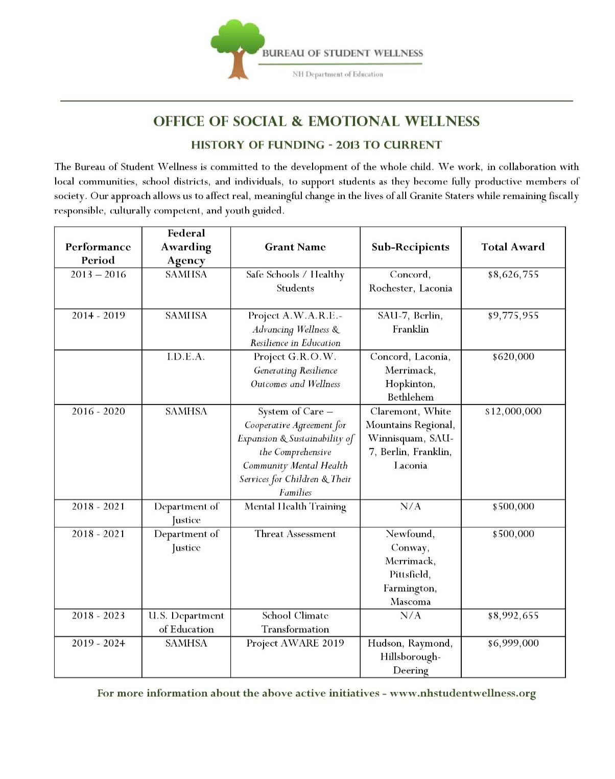

Slide 34

Senate Bill 14 (2019)
A systemic approach to child welfare reform and
ensures children and youth get the appropriate support services
where and when they need them.
Makes improvements in alignment with:
  DCYF Adequacy & Enhancement Assessment
  Family First Prevention Services Act
  10-Year Mental Health Plan
Notes:
Mobile crisis response and stabilization services (MRSS) provide acute mental health crisis stabilization and psychiatric assessment services to children where and when they need them. They aim to provide rapid response, assess the child or youth, resolve crisis situations, and link children, youth and families with needed services.

Slide 35
Senate Bill 14 (cont’d)
Helps children and families in crisis by expanding access to community-based mobile crisis response and stabilization services
Creates an advisory committee
Adds a trauma-informed value to RSA 135 - F
Creates a clearing house and resource center

Slide 36
Senate Bill 6 (2019)
…Gov. Chris Sununu and Senate President Donna Soucy signed off on Senate Bill 6, a measure to dramatically increase the staffing at the agency [DCYF], adding funding for 77 new positions over two years.
To satisfy the first bill, Senate Bill 6, DHHS officials will have to recruit caseworkers and managers to the beleaguered agency: 57 child protective service workers and 20 child protective supervisors in total. That’s an ambitious task complicated by workforce challenges statewide, and the conditions within a department that has seen high levels of turnover in recent years.
Advocates say increasing the positions will go a long way to reducing the workload for protective workers, who as of March had on average 46 assessments per worker – far more than the nationally-recommended average of 15.

Slide 37
House commissions and commitees
HB 111
HB 131

Slide 38
Opportunities for improvement in NH’s System of Care
Shift towards prevention and early intervention, including leveraging the use of Family Resource Centers
Expansion of MTSS-B in NH schools
Broader use of Medicaid to Schools
Rebalance spending from residential and institutional care to community-based interventions
Notes:
The NH children’s behavioral health system remains underfunded and fragmented, leaving children and families without access to the integrated supports needed to address problems early, when treatment is most effective and efficient.
Work remains in order to provide a robust system of care.
The impact of the opioid crisis has taken a significant toll on New Hampshire’s children and families, impacting all child-serving systems.
Adverse childhood experiences can have life-long implications to children’s health and well-being, and investments in this area can mitigate the impact such trauma has on the brain development of children.
While the number of children waiting to access acute inpatient psychiatric services at NHH fluctuates, the fact remains that children are ending up in hospital emergency rooms without access to appropriate services and in highly restrictive settings like SYSC
Children are also being unnecessarily institutionalized instead of receiving services and supports in their homes and communities.
Access to community-based mental health and substance use treatment services is also a statewide challenge, as most Community Mental Health Centers have long waiting lists for services.
Access challenges are exacerbated by workforce shortages and high staff turnover.

Slide 39
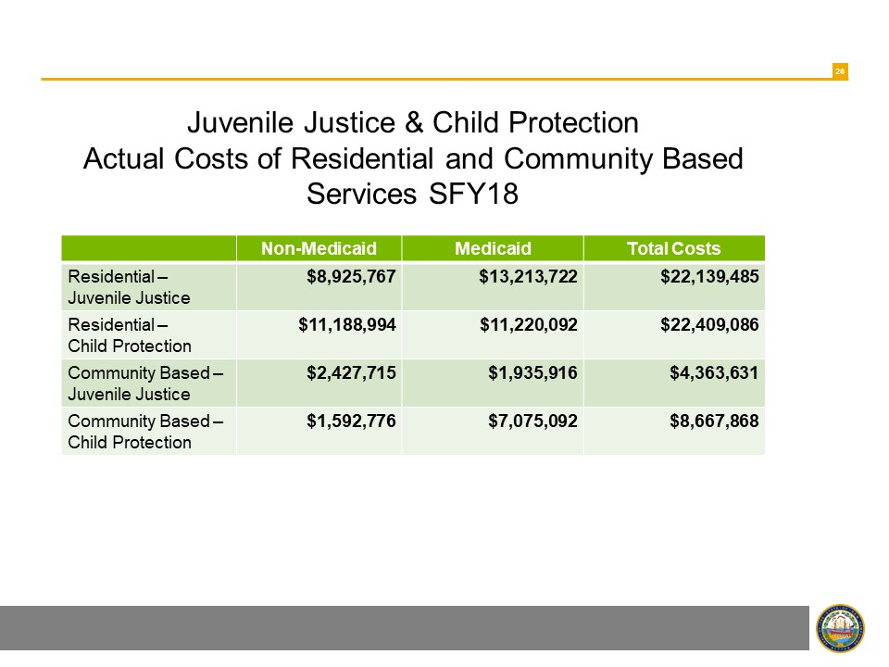
Presented to House Finance Division III
March 15, 2019
Joseph E. Ribsam Jr.

Slide 40
Opportunities for improvement in NH’s System of Care
Preparation for Family First Prevention Services Act
Medicaid rates to incentive the use of evidence-based practices and improve NH’s workforce challenges
Trauma Informed Systems to eventually become Trauma responsive systems
Improve System of Care outcome measurements
Notes:
Family First Prevention Services Act
The federal Family First Prevention Services Act reforms the federal child welfare financing streams to provide services to families who are at risk of entering the child welfare system, including allowing federal reimbursement for evidence-based and trauma-informed “prevention services”, including mental health services, substance use treatment, and in-home parenting skill training. It also seeks to improve the well-being of children by incentivizing states to reduce placement of children in congregate care.
Part of the state’s plan under this Act must include the use of evidence and trauma-informed strategies to better transition youth from residential and in-patient care back into their communities and schools.
States may delay this provision for up to 2 years. However, delays in implementation of these provisions requires a delay in when the state receives federal reimbursement for “prevention services”. New Hampshire will have to comply with all provision by September 29, 2021.
System evaluation and measurement
CBHC used to have an evaluation work group led by Antioch. They developed a framework for shared measurement for the CBH system, but that’s where the work ended. There wasn’t funding to continue that work or will within state government to implement it.
Antioch still conducts the evaluation work for FAST Forward and for the MTSS-B framework, so data is being collected on both those programs.
RSA 135-F requires yearly reporting on the State’s progress in developing a SOC under the statute and each year the requirements are increased.
SB 14 requires CME which would be the logical locus of data collection and outcome measurement
SB 14 also requires performance measurement system of mobile crisis response and stabilization services

Slide 41
Family First Prevention Services Act
Reforms the federal child welfare financing streams to provide services to families who are at risk of entering the child welfare system
Allows for federal reimbursement for evidence-based and trauma-informed “prevention services”, including mental health services, substance use treatment, and in-home parenting skill training
Seeks to improve the well-being of children by incentivizing states to reduce placement of children in congregate care
State’s plan must include the use of evidence and trauma-informed strategies to better transition youth from residential and in-patient care back into their communities and schools
States may delay this provision for up to 2 years. However, delays in implementation of these provisions requires a delay in when the state receives federal reimbursement for “prevention services”. New Hampshire will have to comply with all provisions by September 29, 2021.

Slide 42
Gaps in the service array
Broad array of in-home & community-based services
Sub-acute treatment options
Early childhood interventions
Support for children transitioning into adulthood
Notes:
Lack of HCBS leads to the need for restrictive and costly interventions
Mobile crisis response and stabilization services are a massive gap in our system. When a child is in crisis, the only options now are to call the police or bring them to the ER. That's not where we should be treating our children with the greatest needs.
Mobile crisis response and stabilization services (MRSS) provide acute mental health crisis stabilization and psychiatric assessment services to children where and when they need them. They aim to provide rapid response, assess the child or youth, resolve crisis situations, and link children, youth and families with needed services.
MRSS has been shown to prevent emergency room use, psychiatric hospitalization, residential treatment, and placement disruptions among children and youth who are experiencing a behavioral health crisis.
The services are cost effective when compared to treating children at NHH, SYSC, out of state, or other out of home placement and are a more humane way to treat our children and families.
The lack of sub-acute treatment options represents another gap in care, driving too many children towards services that are either too restrictive or not intense enough.

Slide 43
DCYF RFP – Community Based Voluntary Services
This RFP and the resulting contract for CB-VS also include several features inspired by your RFI responses and our agency’s priorities. These include:
Family voice: Authentic engagement of caregivers, youth, and children throughout service provision is critical to shaping and delivering an effective service. Honoring family voice and choice is a core principle of CB-VS. RFP-2021-DCYF-03-COMMU Page 3 of 44
Building in flexibility: RFI responses stressed the importance of ensuring programs remain flexible (not “one-size-fits-all”) to support the unique needs of each New Hampshire family. In this RFP, we suggest potential EBPs for CB-VS but also invite agencies to offer creative solutions and models to achieve program goals. In addition, providers will be free to customize service planning and deploy a pool of flexible funding to address emergent family needs (e.g., concrete supports, transportation).
Performance improvement: DCYF is looking for partners who are interested in collaborating closely to launch this new program and improve service delivery over time. CB-VS providers will meet regularly with DCYF to review program data, identify areas for improvement, troubleshoot challenges, and develop strategies to enhance program quality and effectiveness together.
Ensuring adequate funding for service delivery: DCYF and RFI respondents both recognize the importance of paying what it takes to deliver results for new programs like CB-VS. In this spirit, we encourage applicants to thoughtfully articulate the variety of costs they will incur to provide CB-VS in their applications. We also plan to provide some initial funding to cover “start-up” costs until service provision can begin.

Slide 44
Multisystemic Therapy (MST)
Keep your eyes open for the next Request for Proposal (RFP) from DCYF.
https://www.mstservices.com/

Slide 45
How can you help?
Sign up for CBHC emails at http://nh4youth.org/email-sign-ups
Amplify CBH messages on social media and in your communities
Attend our events
Participate in CBH policy & advocacy work
Testify at the Statehouse
Write an LTE or Op-Ed
Call or write Elected Officials
Become a CBH-trained advocate

Slide 46

Education & Outreach
Magnify Voices Film and Writing Contest
Film Screenings
Yearly Member Symposium
Mental Health Awareness Events
Building capacity, power, and connecting the dots!
Notes:
To raise awareness, build support and build our coalition all with an eye towards systems change!
https://youtu.be/2sidE6P8m70

Slide 47
Stay in touch!
Cheryl Avery
Policy Coordinator Cavery@new-futures.org
Dellie Champagne
Community Engagement Coordinator
Dchampagne@new-futures.org
Call: (603) 225-9540
Website: new-futures.org
Facebook: https://www.facebook.com/nh4youth/
Twitter: https://twitter.com/NH4youth
Sign up for our emails: https://new-futures.org/email-signup

Slide 48
